Slide 1
Bank Loan Report Project
File created on: 12/11/2024 4:20:23 PM

Slide 2
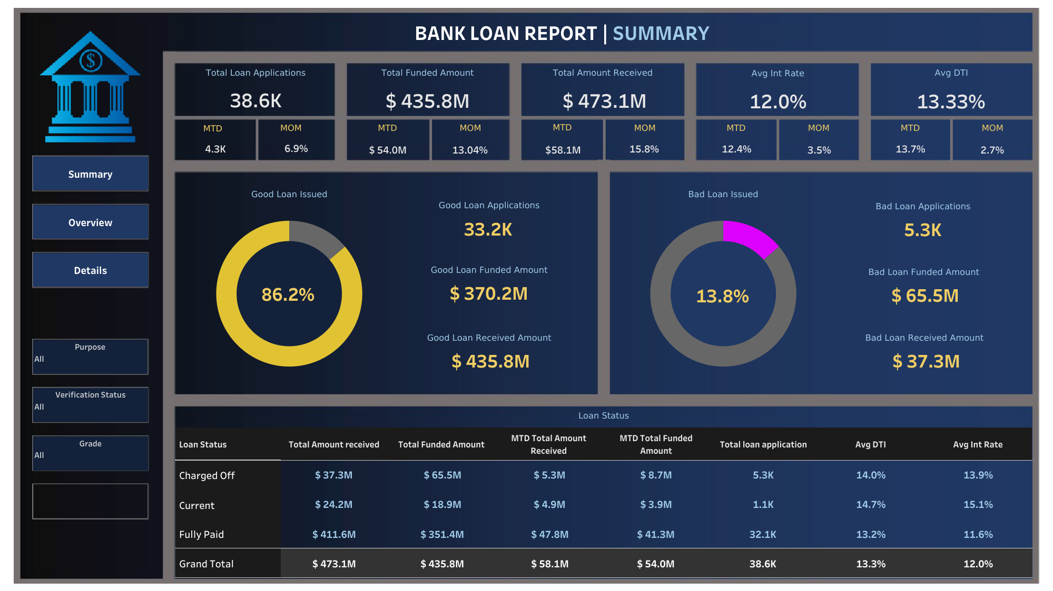

Slide 3
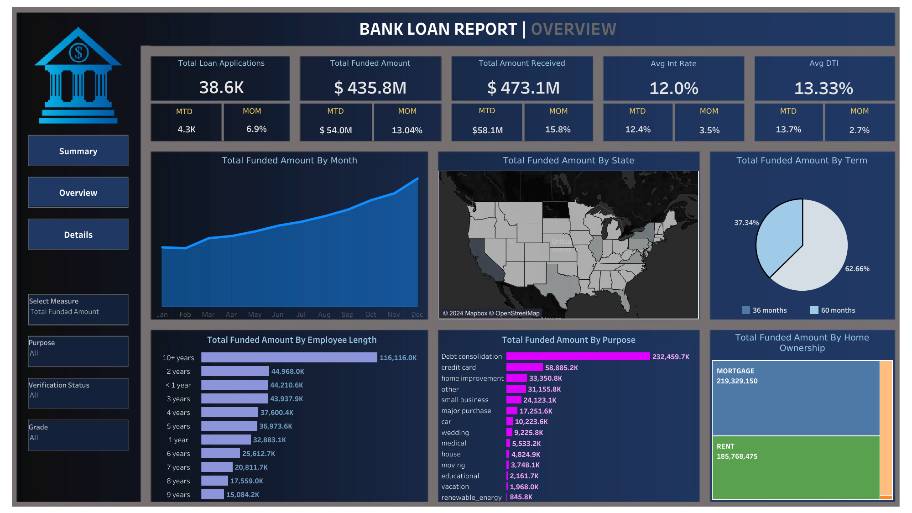

Slide 4
